Slide 1








Fullstack as a service
ECMAScript® 2015
Ziv Rosenzweig
Nodejs - https://nodejs.org/
NPM - npm install npm -g
Bower - npm install -g bower
Gulp - npm install -g gulp

Slide 2



WHO AM I?
Over 15 years as developer/team leader
Over 10 years as a JS developer
Over 2 years with Tikal
Over 25 years as a Squash player

Slide 3

What is the correct name
Developed in 1995 by Brendan Eich of Netscape as Mocha
Changed the to JavaScript as a publicity stunt in 1996
Ecma International took the code and released as “ECMAScript” in 1997.
ECMAScript 2015 (6th edition)
Version | Release date
1 | June 1997
2 | June 1998
3 | December 1999
5 | December 2009
5.1 | June 2011
6 | June 2015
7 | June 2016
Notes:
ECMAScript is the language, whereas JavaScript and JScript are "dialects".

Slide 4
ECMAScript 2015 Goals
Better support for large applications, library creation and compilation target for other languages
Class declarations
Lexical block scoping
Iterators and generators
Promises for asynchronous programming
Cleaner code

Slide 5
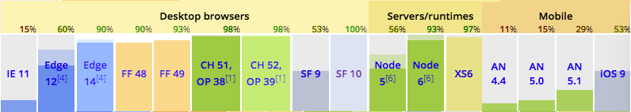
Browser Support
Currently none of the browser support the full ES 2015 specifications
To use it today we use BABEL to transform ES 2015 to ES5
Notes:
Chrome - Only missing tail calls optimization
Safari - All but Symbol.isConcatSpreadable

Slide 6
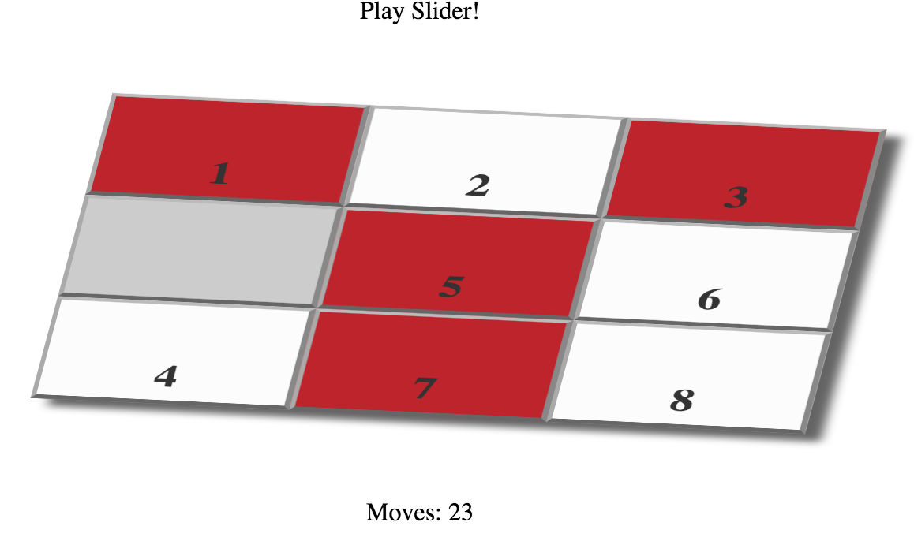
Slide game
The Game
ES5.1
git clone https://github.com/zivr/ES2015Workshop.git
git checkout ES5.1
Notes:
git clone git@github.com:zivr/ES2015Workshop.git
cd ES2015Workshop/
git checkout ES5.1
npm install
bower install

Slide 7
Immediately Invoked Function Expression (IIFE)
ES5
(function() {
….
})()
ES2015
{
....
}

Slide 8
Hands-on
Change HTML script code to use ES2015 IIFE
Notes:
git checkout IIFE

Slide 9
New keywords - let
The let statement declares a block scope local variable, optionally initializing it to a value.
It doesn’t matter if you defined the variable at the beginning or the end of the block.
function foo() {
let x = 1;
if (true) {
let x = 2; // different variable
console.log(x); // 2
}
console.log(x); // 1
}
Notes:
let allows you to declare variables that are limited in scope to the block, statement, or expression on which it is used. This is unlike the var keyword, which defines a variable globally, or locally to an entire function regardless of block scope.

Slide 10
New keywords - let
In loops, you get a fresh binding for each iteration if you let-declare a variable.
for (var i = 0; i<10; i++) {
console.log(i); // 0, 1, 2, ... 9
}
console.log(i); // i is defined
for (let i = 0; i<10; i++) {
console.log(i); // 0, 1, 2, ... 9
}
console.log(i); // i is not defined

Slide 11
New keywords - let
let, unlike var, does not create a property on the global object.
var x = 5
console.log(window.x); // 5
let x = 5
console.log(window.x); // x is not defined

Slide 12
New keywords - const
The const declaration creates a read-only reference to a value.
It doesn’t makes the object immutable.
const x = 5
x = 3 //Uncaught TypeError: Assignment to constant variable.
const obj = { x:5 }
obj.x = 6

Slide 13
Arrow function
When using arrow function syntax the context is “inherited” to the function
function () { … } == () => { … };
function (v) { return v+1 } == v => v+ 1;
function startTimer() {
this.seconds = 0;
window.setInterval(() => this.seconds++, 1000);
}
Notes:
let arr = [];
for (var i=0; i < 3; i++) {
arr.push(() => i);
}
console.log(arr.map(x => x()));
------------
var runFunc = function(func){
func();
}
class Foo{
constructor(){
this.prop = 'Foo prop';
}
run(){
console.log('prop in run = \'' + this.prop+ '\'');
runFunc(function(){
console.log('prop in runFunc = \'' + this.prop+ '\'');
}.bind(this));
runFunc(()=>{
console.log('prop in runFunc = \'' + this.prop+ '\'');
});
}
}
let f = new Foo();
f.run();

Slide 14
Class
New in ECMAScript 2015
Can be transformed to a normal function
Doesn’t support private/public/protected
Support getter and setter
Support static functions
class Shape { constructor (x, y) { this.x = x;
this.y = y; } }

Slide 15
Class - getter/setter
class Shape { constructor (x, y) { this._x = x this._y = y
} get xPos() {
return this._x;
}
set xPos(value) {
this._x = value;
}
}

Slide 16
Class - super
class Circle extends Shape { constructor (x, y, radius) { super(x, y) this.radius = radius }
paint(color) {
//…
}
}

Slide 17
Class - static
class Rectangle extends Shape { constructor (x, y, width, height) { super(x, y) this.width = width this.height = height } static createDefault() { return new Rectangle(0,0,50,50); } }

Slide 18
Hands-on
Convert Board.js
Use Class and not function and prototype.
Use getter and setter
Use Arrow functions
Use let or const and not var
Notes:
git checkout Class
Board.js
Convert to class
Use getter and setter
Struct object as a static getter
talk about scope in loops (use let i= and not var i)
sliderViews.js
Convert to class
Use arrow function and don’t use self=this
Games.js
Convert to class
Static method

Slide 19
Hands-on - Going crazy
Create a function that dynamically create a class
Notes:
class TwoWheels { constructor(name) { this._name = name; } get wheelBase() { return 2; } get name() { return this._name; } } class FourWheels { constructor(name) { this._name = name; } get wheelBase() { return 4; } get name() { return this._name; } } const createWheelBaseClass = (baseClass) => { let dynamicClass = class newClass extends baseClass { constructor(...args) { super(...args); //Do something } }; return dynamicClass; }; let Bicycle = createWheelBaseClass(TwoWheels); let Car = createWheelBaseClass(FourWheels); let bmx = new Bicycle('BMX'); console.log(bmx.name + ' has ' + bmx.wheelBase + ' wheels.'); let ferrari = new Car('Ferrari'); console.log(ferrari.name + ' has ' + ferrari.wheelBase + ' wheels.');

Slide 20
Classes in Frameworks
Classes are functions that can be initialized using new argument.
Angular controllers
React Component
class CstomerController {
constructor(service){}
}
angular.module(’Tikal').controller(’CustomersController’, [’service',CstomerController]);
class HelloMessage extends React.Component { render() { return <div>Hello {this.props.name}</div>; } } React.render(<HelloMessage name="Sebastian" />, mountNode);
Notes:
Knockout request an object so any class is great or you can use something like knockout-es6 to make life easier

Slide 21
Class - private/protected/public
No support . However they are defined as reserved word
Symbol was brought to enable private properties
Few suggestion as a work around
Closures
Symbols
let nameSymbol = Symbol('name'); class Company { constructor(name){ this[nameSymbol] = name } getName () { return this[nameSymbol] }; }

Slide 22
Symbol
Symbol - primitive value that represents a unique, non-String Object
Great to defined properties that can’t be overridden by external modules
Symbol(‘foo’) !== Symbol(‘foo’)
const foo = Symbol()
typeof foo === ‘symbol’
Notes:
Symbol("foo") !== Symbol("foo")
const foo = Symbol()
const bar = Symbol()
typeof foo === "symbol"
typeof bar === "symbol"
let obj = {}
obj[foo] = "foo"
obj[bar] = "bar"
JSON.stringify(obj) // {}
Object.keys(obj) // []
Object.getOwnPropertyNames(obj) // []
Object.getOwnPropertySymbols(obj) // [ foo, bar ]

Slide 23
Symbol
getOwnPropertySymbols – returns an array of all symbol properties found directly upon a given object.
let obj = {}
obj[foo] = "foo"
JSON.stringify(obj) // {}
Object.keys(obj) // []
Object.getOwnPropertyNames(obj) // []
Object.getOwnPropertySymbols(obj) // [ foo]
Notes:
Symbol("foo") !== Symbol("foo")
const foo = Symbol()
const bar = Symbol()
typeof foo === "symbol"
typeof bar === "symbol"
let obj = {}
obj[foo] = "foo"
obj[bar] = "bar"
JSON.stringify(obj) // {}
Object.keys(obj) // []
Object.getOwnPropertyNames(obj) // []
Object.getOwnPropertySymbols(obj) // [ foo, bar ]

Slide 24
Map
Collections of key/value pairs where both objects and primitive values may be used as either a key or a value.
let m = new Map()
m.set("hello", 42)
m.set(s, 34)
m.get(s) === 34
m.size === 2
Notes:
var wm = new WeakMap();
var obj = {};
var obj2 = {};
wm.set(obj, 37);
wm.set(obj2, 55);
console.log(wm.get(obj))
console.log(wm.get(obj2))

Slide 25
WeakMap
collections of key/value pairs where the keys are objects and values may be arbitrary values.
Primitive data types as keys are not allowed
The key in a WeakMap is held weakly - if there are no other strong references to the key, then the entire entry will be removed from the WeakMap by the garbage collector.
Notes:
var wm = new WeakMap();
var obj = {};
var obj2 = {};
wm.set(obj, 37);
wm.set(obj2, 55);
console.log(wm.get(obj))
console.log(wm.get(obj2))

Slide 26
Iterable protocol
The iterator protocol defines a standard way to produce a sequence of values (either finite or infinite).
for (let x of ['a', 'b', 'c']) {
console.log(x);
}
//a
//b
//c

Slide 27
Iterable protocol
An iterable object is an object the implement the @@iterator method.
let fooStr= ”Just another string";
typeof fooStr[Symbol.iterator]; // "function"

Slide 28
Iterator protocol
An iterator is an object with a next method that returns { done, value } tuples.
function foo(){
let f=0;
return {
next:() => {
return {value: f++, done: f>2} ;
}
}
}
const iterator = foo();
iterator.next();
//{value: 0, done: false}
iterator.next();
//{value: 1, done: false}
iterator.next();
//{value: 2, done: true}

Slide 29
Iterator protocol
An iterator is an object with a next method that returns { done, value } tuples.
function makeFibIterator(){
let fib0 = 0; let fib1 = 0;
return {
next:() => {
if (!fib1) { fib1 = 1; return {value: 1, done: false};}
let result = fib0 + fib1;
fib0 = fib1; fib1 = result;
return {value: result, done: false} ;
}
}
}

Slide 30
Iterable protocol
@@iterator is a zero arguments function that return an iterator object.
class Foo{ constructor(){ this.f = 0; } [Symbol.iterator]() { return { next: () => { return { value: this.f++, done: this.f > 3}; } } } }
for(let i of new Foo()){
console.log(i);
}
//0
//1
//2
Notes:
const DAYS = Object.freeze({ Sun : 0, Mon: 1, Tue : 2, Wed: 3, Thu : 4, Fri: 5, Sat: 6});
class Scheduler{
constructor(){
this._days = ['Sun', 'Mon', 'Tue', 'Wed', 'Thu', 'Fri', 'Sat'];
this._schedule = Array.apply(null, Array(7)).map(() => []);
}
fillSchedule(day, time, comments){
let dayOfWeek = this._schedule[day];
dayOfWeek.push({time, comments});
}
[Symbol.iterator]() {
let schedule = [];
(let day of this._schedule){
if (day){
for(let appointment of day){
schedule.push(appointment);
}
}
}
return {
next: function() {
if (schedule.length > this._iteratorIdx){
return { value: schedule[this._iteratorIdx++], done: false };
}
else {
return { done: true };
}
},
_iteratorIdx: 0
};
}
}
let mySchedule = new Scheduler();
mySchedule.fillSchedule(DAYS.Sun, 9, 'learn JS');
mySchedule.fillSchedule(DAYS.Sun, 10, 'start learning ES6');
mySchedule.fillSchedule(DAYS.Mon, 8, 'Get the kids to school');
mySchedule.fillSchedule(DAYS.Mon, 11, 'Prepair lecture');
mySchedule.fillSchedule(DAYS.Tue, 17, 'Play Squash');
for(let appointment of mySchedule){
console.log(appointment.time + '--' + appointment.comments);
}

Slide 31
for .. of
Creates a loop iterating over iterable objects.
Array
String
let iterable = [10, 20, 30];
for (let value of iterable) {
console.log(value);
}
//10
//20
//30
let iterable = "boo";
for (let value of iterable) {
console.log(value);
}
//b
//o
//o
Notes:
const DAYS = Object.freeze({ Sun : 0, Mon: 1, Tue : 2, Wed: 3, Thu : 4, Fri: 5, Sat: 6});
class Scheduler{
constructor(){
this._days = ['Sun', 'Mon', 'Tue', 'Wed', 'Thu', 'Fri', 'Sat'];
this._schedule = Array.apply(null, Array(7)).map(() => []);
}
fillSchedule(day, time, comments){
let dayOfWeek = this._schedule[day];
dayOfWeek.push({time, comments});
}
[Symbol.iterator]() {
let schedule = [];
(let day of this._schedule){
if (day){
for(let appointment of day){
schedule.push(appointment);
}
}
}
return {
next: function() {
if (schedule.length > this._iteratorIdx){
return { value: schedule[this._iteratorIdx++], done: false };
}
else {
return { done: true };
}
},
_iteratorIdx: 0
};
}
}
let mySchedule = new Scheduler();
mySchedule.fillSchedule(DAYS.Sun, 9, 'learn JS');
mySchedule.fillSchedule(DAYS.Sun, 10, 'start learning ES6');
mySchedule.fillSchedule(DAYS.Mon, 8, 'Get the kids to school');
mySchedule.fillSchedule(DAYS.Mon, 11, 'Prepair lecture');
mySchedule.fillSchedule(DAYS.Tue, 17, 'Play Squash');
for(let appointment of mySchedule){
console.log(appointment.time + '--' + appointment.comments);
}

Slide 32
for .. of
Creates a loop iterating over iterable objects.
Map
let iterable = new Map([["a", 1], ["b", 2], [{key: "c"}, 3]]);
for (let entry of iterable) {
console.log(entry);
}
//["a", 1]
//["b", 2]
//[Object, 3]

Slide 33
Generators
The Generator object is returned by a generator function and it conforms to both the iterator and the Iterable protocol.
The function* declaration defines a generator function, which returns a Generator object.
The yield keyword is used to pause and resume a generator function
Notes:
function* fibonacci() {
let fib0 = 0; let fib1 = 1;
yield fib1;
while(true) {
let result = (fib0 + fib1);
yield result;
fib0 = fib1, fib1 = result;
}
}

Slide 34
Generators
function* foo(){
yield 1;
yield 2;
yield 3;
}
const iterator = foo();
iterator.next();
//{value: 1, done: false}
iterator.next();
//{value: 2, done: false}
iterator.next();
//{value: 3, done: true}
for(let i of foo()){
console.log(i);
}
//1
//2
//3
Notes:
function* fibonacci() {
let fib0 = 0; let fib1 = 1;
yield fib1;
while(true) {
let result = (fib0 + fib1);
yield result;
fib0 = fib1, fib1 = result;
}
}

Slide 35
Generators
function* makeFibIterator(){
let fib0 = 0; let fib1 = 0; let result = null;
yield fib1;
while(true) {
yield result = fib0 + fib1;
fib0 = fib1; fib1 = result;
}
}

Slide 36
Generators
The yield* expression is used to delegate to another generator or iterable object.
function* foo(){
yield 1;
yield 2;
}
function* goo() {
yield* foo();
yield 3;
}
const iterator = goo();
iterator.next();
//{value: 1, done: false}
iterator.next();
//{value: 2, done: false}
iterator.next();
//{value: 3, done: true}

Slide 37
Hands-on
Make SquareCollection a generator Object
Notes:
git checkout iterator

Slide 38
Promises
A Promise represents an operation that hasn't completed yet, but is expected in the future
The Promise object is used for deferred and asynchronous computations.
let promise = new Promise((resolve, reject) => {
//async code
//at the end call resolve or reject function
});

Slide 39
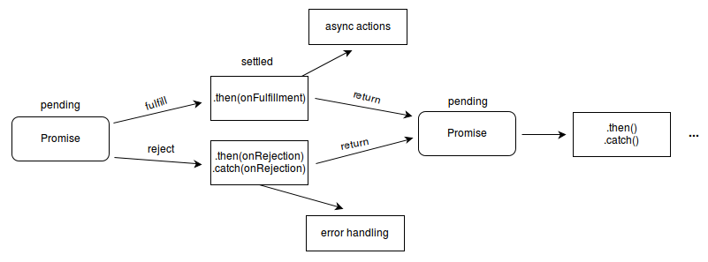
Promises
A Promise is in one of these states:
pending: initial state, not fulfilled or rejected.
fulfilled: meaning that the operation completed successfully.
rejected: meaning that the operation failed.

Slide 40
Promises - then
Returns a Promise.
Takes two callback functions resolve and reject
function msgAfterTimeout (who) {
return new Promise((resolve, reject) => {
setTimeout(() => resolve(`Hello ${who}!`), 1000);
});
}
msgAfterTimeout(‘ES2015’)
.then((msg) => msg + ‘ Goodbye ES5.1’)
.then((msg) => { console.log(msg);});
Notes:
//Hello ES2015! Goodbye ES5.1

Slide 41
Promise - all
Returns a Promise.
resolves when all of the promises have resolved, or rejects with the reason of the first passed promise that rejects.
var p1 = Promise.resolve(3);
var p2 = 1337;
var p3 = new Promise((resolve, reject) => {
setTimeout(resolve, 100, "foo");
});
Promise.all([p1, p2, p3]).then(values => {
console.log(values); // [3, 1337, "foo"]
});
Notes:
var p1 = new Promise((resolve, reject) => {
setTimeout(resolve, 1000, "one");
});
var p2 = new Promise((resolve, reject) => {
setTimeout(resolve, 2000, "two");
});
var p3 = new Promise((resolve, reject) => {
setTimeout(resolve, 3000, "three");
});
var p4 = new Promise((resolve, reject) => {
setTimeout(resolve, 4000, "four");
});
var p5 = new Promise((resolve, reject) => {
setTimeout(reject, 2000, "five");
});
Promise.all([p1, p2, p3, p4, p5]).then(value => {
console.log(value);
}, function(reason) {
console.log(reason)
});

Slide 42
Hands-on
Lets say they isSolvable takes allot of time to be resolve. Lets call it a synchronically by returning a promise
Notes:
git checkout Promise

Slide 43
Hands-on
Task - create a recursive function that use Promise
Notes:
var fib = (num) => {
return new Promise((resolve) => {
if (num < 2) {
resolve(1);
}
else {
let fib2;
fib(num - 1)
.then((val) => {
fib2 = val;
return fib(num - 2)})
.then((fib1) => {
resolve(fib1 + fib2);
});
}
})
}
fib(5).then((val) => {console.log(val);})

Slide 44
Template string
string literals allowing embedded expressions.
Support multi-line and string interpolation
var classRoom = { rows: 7, cols: 2 , name: 'Tikal' }
var message = `we have ${classRoom.rows * classRoom.cols * 2} chairs
in ${classRoom.name}`
console.log(message) //we have 28 chairs in Tikal

Slide 45
Rest Parameters
Allows us to represent an indefinite number of arguments as an array.
function foo(a, b, ...args) {
// ...
}
foo(1,2,3,4,5,6); //args = [3,4,5,6]
function goo(a, b, ...args) {
foo(…args); //call foo(3,4,5,6)
foo(args); //call foo([3,4,5,6])
}
goo(1,2,3,4,5,6);
Notes:
The main differences between rest parameters and the arguments object:
rest parameters are only the ones that haven't been given a separate name, while the arguments object contains all arguments passed to the function;
the arguments object is not a real array, while rest parameters are Array instances, meaning methods like sort, map, forEach or pop can be applied on it directly;
the arguments object has additional functionality specific to itself (like the callee property).

Slide 46
Hands-on
one line array initialization at board.js
Notes:
git checkout rest

Slide 47
Default Parameters
Allow formal parameters to be initialized with default values if no value or undefined is passed.
function playSport(sportName) {
sportName= sportName|| ‘Squash’;
...
}
function playSport(sportName = ‘Squash’) {
...
}
Notes:
Why not to use the old or operator for initialization.
1) It takes time for this hack to become intuitive
2) using || to set default values breaks down when falsy values, like 0 or “”, are passed into the function.
function multiply(a, b = 1) {
return a*b;
}
multiply(5); // 5

Slide 48
Destructuring
A new syntax that makes it possible to extract data from arrays or objects into distinct variables.
ES5
var x = [1, 2, 3, 4, 5]
ES2015
const [y, z] = x
console.log(y); // 1
console.log(z); // 2
Notes:
var a, b, rest;
[a, b] = [1, 2]
console.log(a) // 1
console.log(b) // 2
[a, b, ...rest] = [1, 2, 3, 4, 5]
console.log(a) // 1
console.log(b) // 2
console.log(rest) // [3, 4, 5]
({a, b} = {a:1, b:2})
console.log(a) // 1
console.log(b) // 2

Slide 49
Destructuring - Array
let a, b;
[a, b] = [1, 2];
console.log(a); // 1
console.log(b); // 2
[a=5, b=7] = [1];
console.log(a); // 1
console.log(b); // 7

Slide 50
Destructuring - Array for Swapping
let a = 1;
let b = 3;
[a, b] = [b, a];
console.log(a); // 3
console.log(b); // 1

Slide 51
Destructuring - Array with functions
function f() {
return [1, 2, 3];
}
const [a, , b] = f();
console.log(a); // 1
console.log(b); // 3

Slide 52
Destructuring - Map with for loop
const iterable = new Map([["a", 1], ["b", 2], [{key: "c"}, 3]]);
for (let entry of iterable) {
console.log(entry);
}
//["a", 1]
//["b", 2]
//[Object, 3]
for (let [key, value] of iterable) {
console.log(value);
}
//1
//2
//3

Slide 53
Destructuring - Array real usage
const url = "http://www.tikalk.com";
const parsedURL = /^(\w+)\:\/\/([^\/]+)\/(.*)$/.exec(url);
// ["https://www.tikalk.com", "http", ”www.tikalk.com", “"]
const [, protocol, fullhost, fullpath] = parsedURL;
console.log(protocol); // "https"

Slide 54
Destructuring - Object
const o = {p: 42, q: true};
let {p, q} = o;
console.log(p); // 42
console.log(q); // true
let a, b;
({a, b} = {a:1, b:2});
const o = {p: 42, q: true};
let {p: foo, q: bar} = o;
console.log(foo); // 42
console.log(bar); // true
let {a=10, b=5} = {a: 3};
console.log(a); // 3
console.log(b); // 5

Slide 55
Destructuring - Object with for loop
const languages = [ { name: ‘JavaScript’ , version : { last: 6 , ....} ... } ,
{8 , ....} ... } ]
for (let {name: lang, version: { last: currentVer } } of languages) {
console.log(lang+ ‘ current version is: ‘ + currentVer);
}
//Javascript current version is: 6

Slide 56
Hands-on
onSwapSquares
onSquareClicked

Slide 57
ES2016
From now on we will get a small releases.
New features include:
Array.prototype.includes(value : any) : boolean
exponentiation operator (**)
ES5
Math.pow(x, y)
ES2015
x ** y

Slide 58

THANK YOU
Ziv Rosenzweig
Email: ziv@tikalk.com
Tel: +972-52-8814271

